Slide 1
HNDIT 2312-Principles of Software Engineering
Week 5: Software Design-1(UML)

Slide 2
Topics Covered
Software design activities
System modeling
Unified Modeling Language(UML)
Behavioral models
Use case diagram

Slide 3
Software design from week-2
Architectural Design
Interface Design
Component Design
Database Design

Slide 4
How to design Software?
Requirement gathering
Requirement specification(SRS)
Functional requirements
Decision tables
System modeling
Use case diagram (UML)
Data flow diagram(DFD)

Slide 5
System modeling
System modeling is the process of developing abstract models of a system, with each model presenting a different view or perspective of that system.
System modeling has now come to mean representing a system using some kind of graphical notation used with Unified Modeling Language (UML)

Slide 6
Unified Modeling Language(UML)
A UML diagram is a partial graphical representation (view) of a model of a system under design, implementation, or already in existence.
UML specification defines two major kinds of UML diagram:
Structure diagrams
Behavior diagrams.

Slide 7
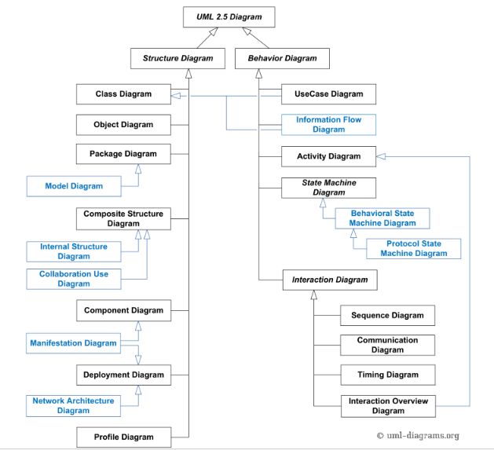
Classification of UML 2.5

Slide 8
Behavior Diagrams
Use case diagram
Activity diagram
State machine diagram
Interaction diagram
Sequence diagram
Communication diagram

Slide 9
Structural diagrams
Class diagram
Object diagram
Collaboration diagram
Component diagram
Deployment diagram
Network architecture diagram

Slide 10
Use case modeling
Use cases were developed originally to support requirements elicitation and now incorporated into the UML.
Each use case represents a discrete task that involves external interaction with a system.
Actors in a use case may be people or other systems.
Represented diagrammatically to provide an overview of the use case and in a more detailed textual form.

Slide 11
Use case diagram
Use case diagrams are usually referred to as behavior diagrams used to describe a set of actions (use cases) that some system or systems (subject) should or can perform in collaboration with one or more external users of the system (actors).

Slide 12
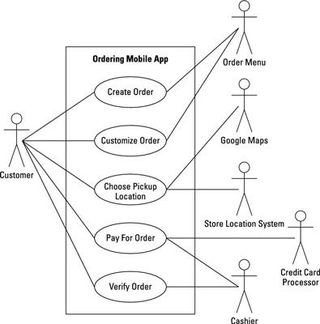
Example Use case

Slide 13
Components of a Use case
Subject or System boundary
Actors
Use cases
Relationship(Links)
Association
Generalization
Dependency

Slide 14
UML Actor
An actor is behavioral classifier which specifies a role played by an external entity that interacts with the subject (e.g., by exchanging signals and data), a human user of the designed system, some other system or hardware using services of the subject.

Slide 15
UML Subject
A subject of a use case defines and represents boundaries of a business, software system, physical system or device, subsystem, component.
Subject (sometimes called a system boundary) is presented by a rectangle with subject's name, associated keywords and stereotypes in the top left corner.

Slide 16
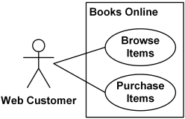
UML Subject
Examples of business subjects
Department Store
Airport
Restaurant

Slide 17

UML Actor
All actors must have names according to the assumed role. Examples of actor names (user roles):
Customer
Web Client
Student
Passenger
Payment System

Slide 18
UML Use Case
Use cases allow to capture requirements of systems under design or consideration, describe functionality provided by those systems, and determine the requirements the systems pose on their environment.

Slide 19

UML Use Case
The only requirement is that each use case must have a name.
Examples of use case names:
Make Purchase
Place Order
Update Subscription
Transfer Funds
Hire Employee
Manage Account

Slide 20
UML Association
Each use case represents a unit of useful functionality that subjects provide to actors. An association between an actor and a use case indicates that the actor and the use case somehow interact or communicate with each other.
Only binary associations are allowed between actors and use cases.
An actor could be associated to one or several use cases.

Slide 21
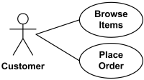
UML Association

Slide 22

UML Association
A use case may have one or several associated actors.

Slide 23

UML Use Case Extend
Extending use case typically defines optional behavior that is not necessarily meaningful by itself. The extend relationship is owned by the extending use case.

Slide 24
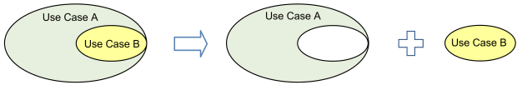
UML Use Case Include
The include relationship could be used:
to simplify large use case by splitting it into several use cases,
to extract common parts of the behaviors of two or more use cases.

Slide 25
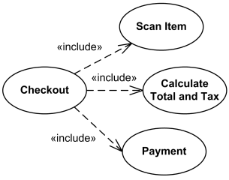
UML Use Case Include
Large and complex Checkout use case has several use cases extracted, each smaller use case describing some logical unit of behavior.

Slide 26
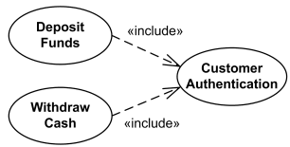
UML Use Case Include
Deposit Funds and Withdraw Cash use cases include Customer Authentication use case.

Slide 27
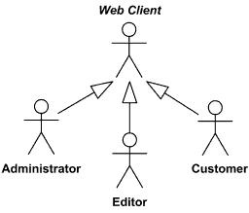
Relationships Between Actors
We can define abstract or concrete actors and specialize them using generalization relationship.

Slide 28
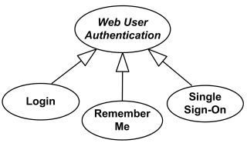
Use case Generalization
The child use case inherits the behavior and meaning of the parent use case.

Slide 29
How to draw UML use case diagram?
Define system boundary
Define actors
Define use cases
Describe use case behavior

Slide 30
Key points
A model is an abstract view of a system that ignores system details.
Object oriented design paradigm(UML diagram).
Use cases describe interactions between a system and external actors.

